Slide 1
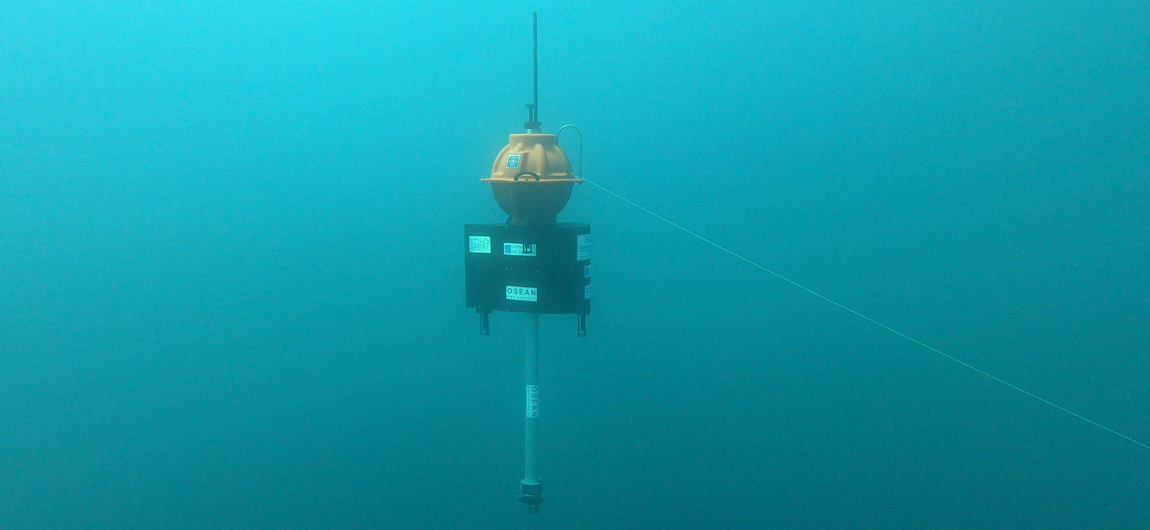
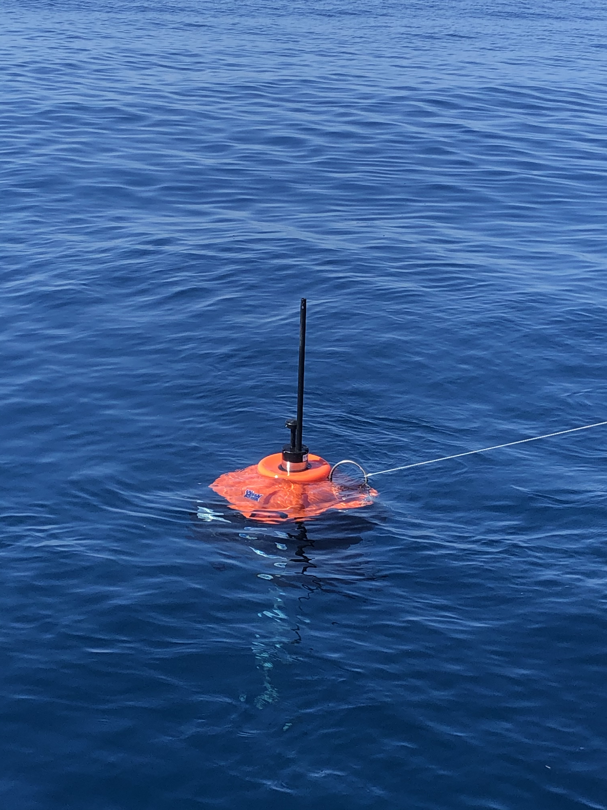
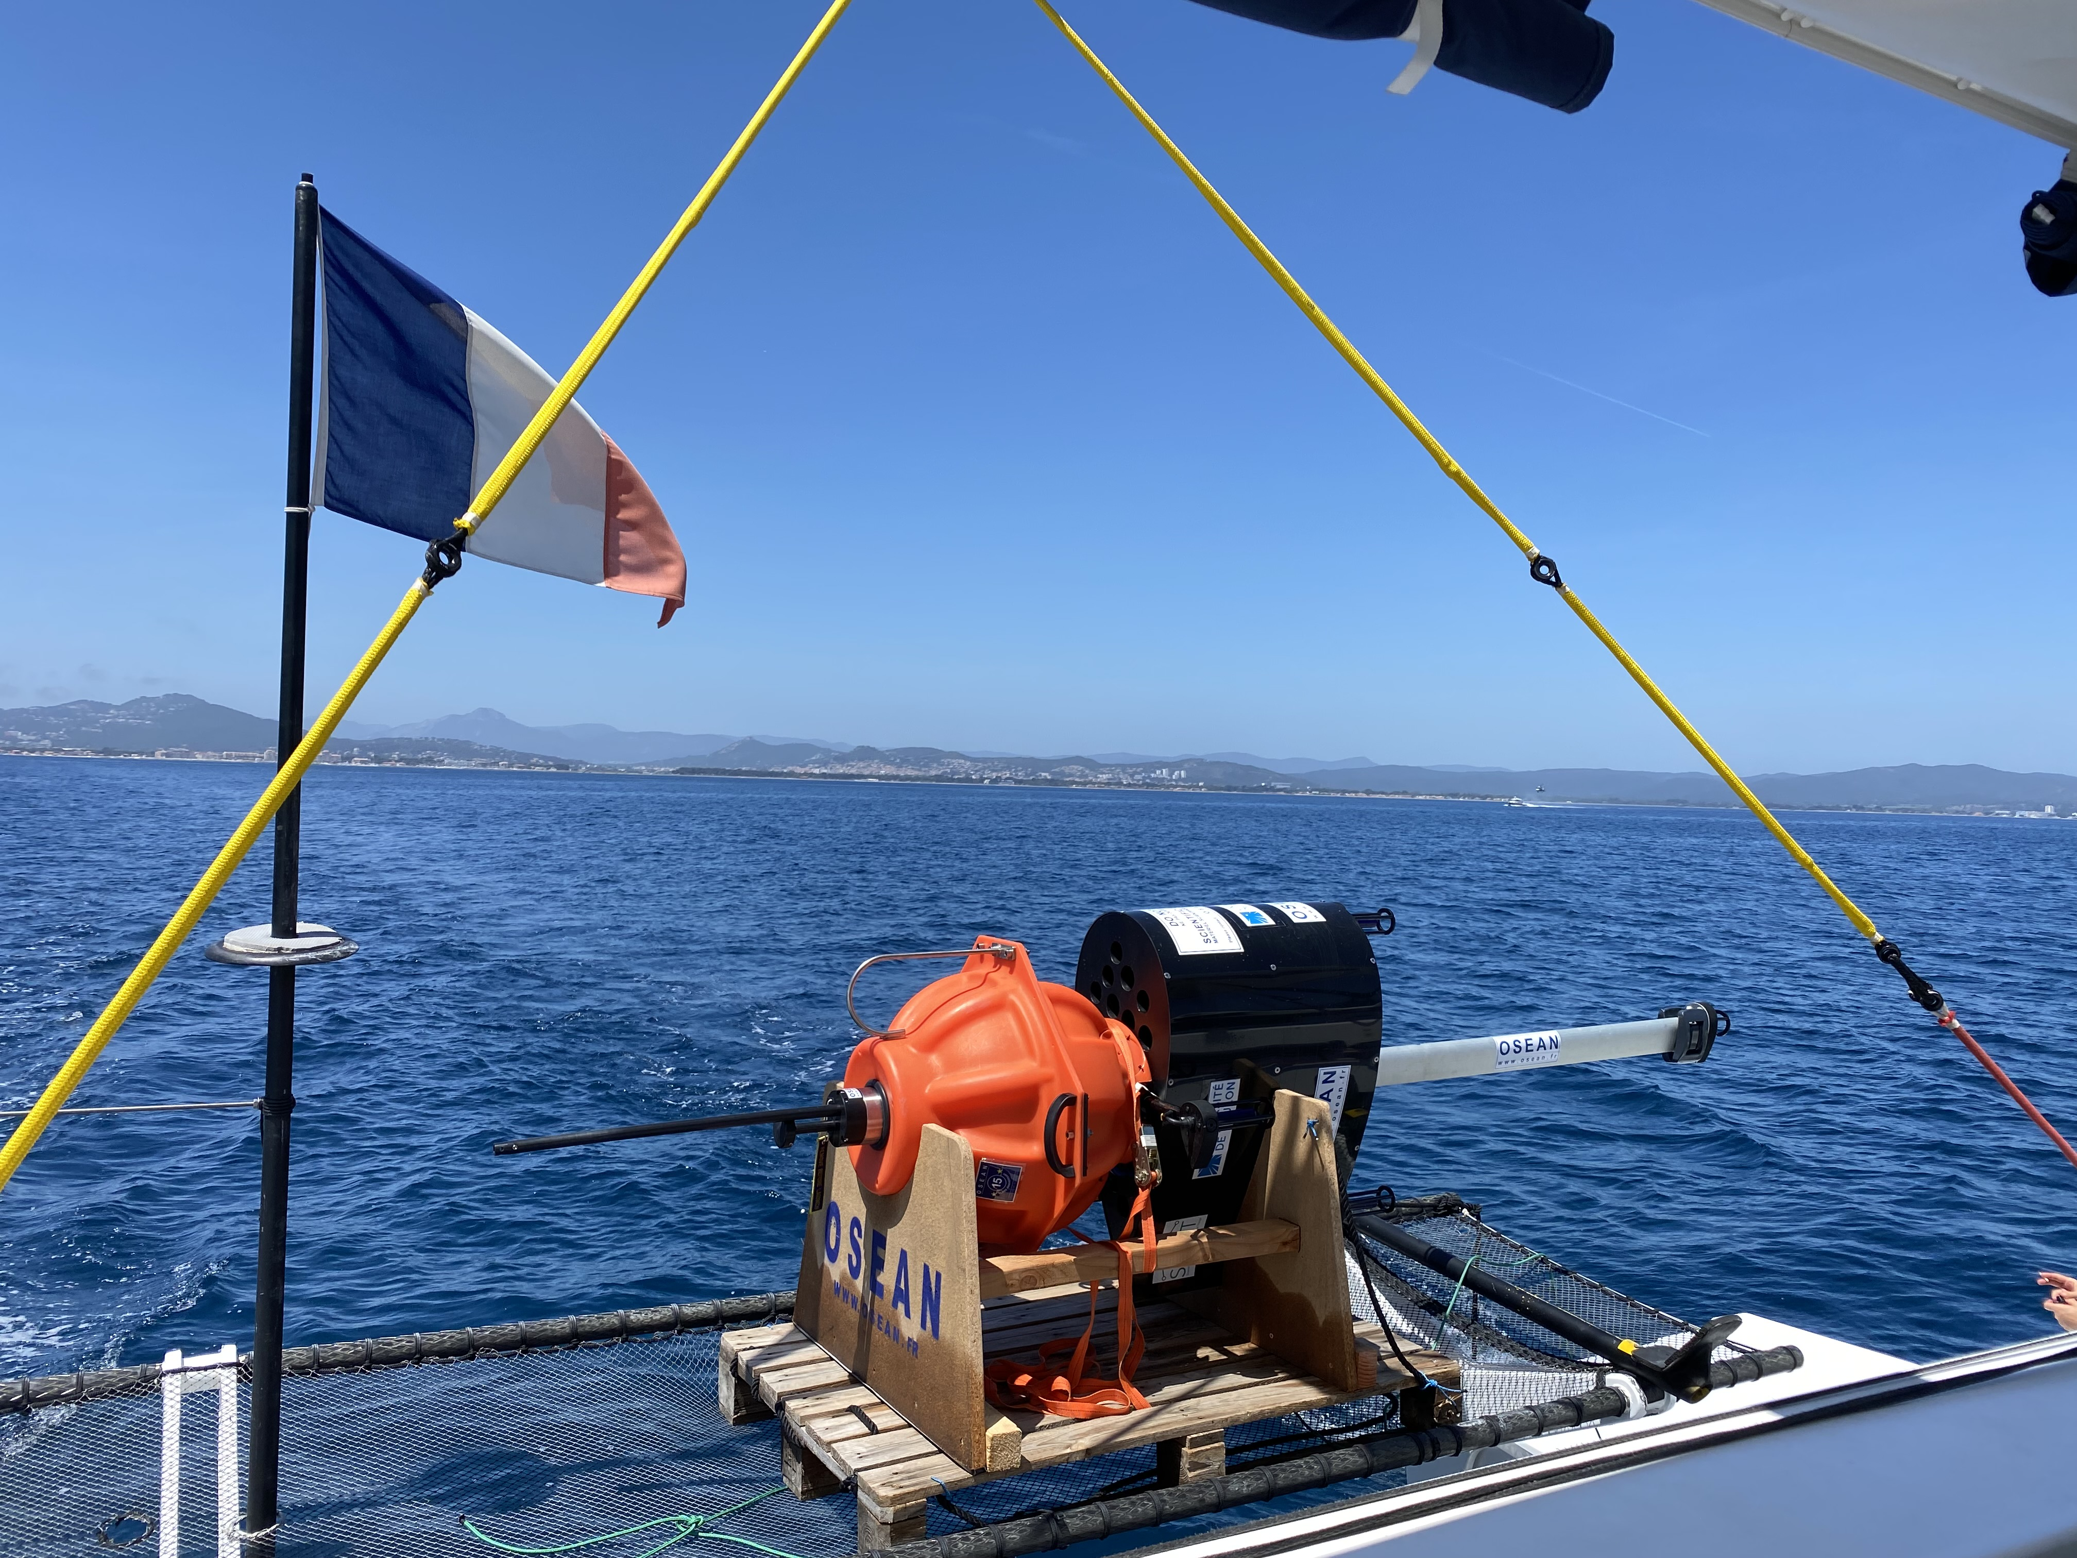
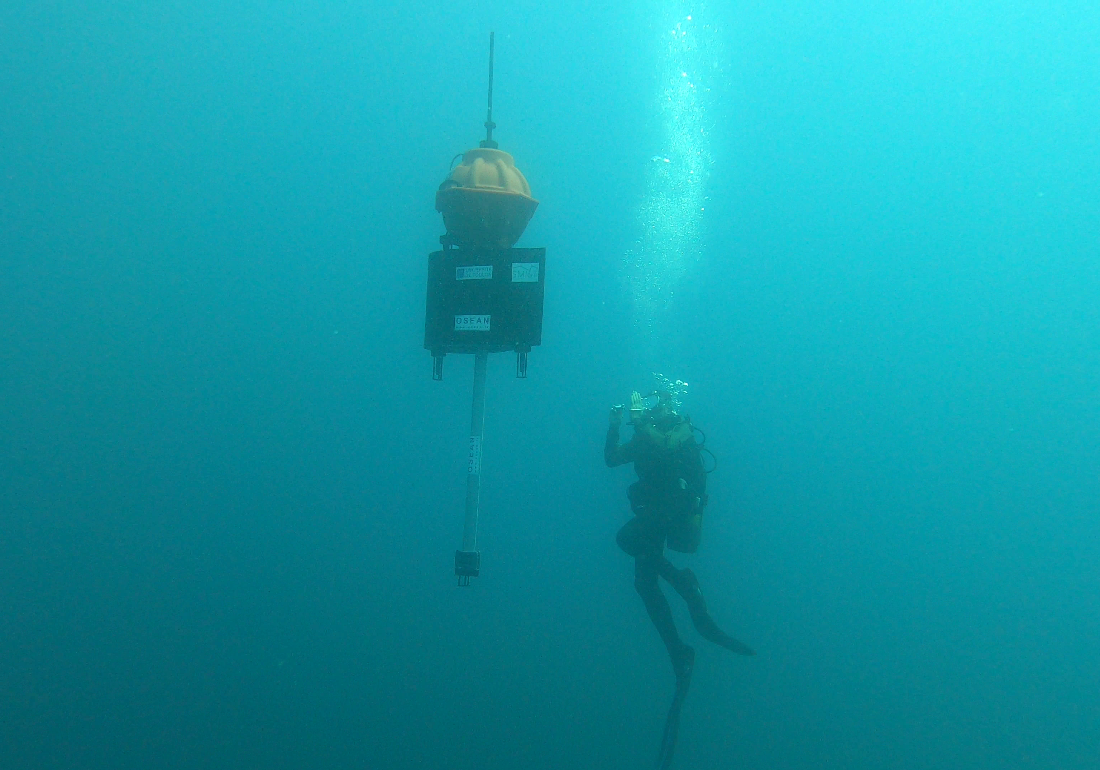
Whale detection & ship collision avoidance in the Mediterranean Sea
Bombyx2 results of the joint research of DYNI LIS CNRS U. Toulon & OSEAN in FEDER GIAS MARITTIMO
Double objective : environmental & commercial
Bombyx2 is an underwater acoustic buoy to avoid collision between cetaceans and ships. It was designed with the double objective of :
Improving the cohabitation between human activities and the ecosystem, by detecting and localizing groups of cetaceans moving underwater and avoiding possible harmful collisions,
Reducing the enormous costs of inspecting and repairing merchant ships.
How it works
Sea trials
Full project
Bombyx2 (~60 kg) is immersed at -25 m. It is equipped with 5 hydrophones and embedeed Artificial Intelligence. It is able to detect cetaceans and estimate their position, hence to autonomously transmit an alert to a server which is redistributing it to the vessels which are part of the Repcet cetacean detection network.
Following several tests done at OSEAN’s facilities and at sea, a prototype has been publicly testedon May 2021, and showed in a national TV news. Each Bombyx2 has a detection range of at least 15 km for Cachalot, and even more for Fin Whale.
The two first Bombyx2 buoys will be installed in the autumn 2021 near and in collaboration with the Port-Cros National Park and the Cap Corse Park. Then, a dozen of Bombyx2 will be placed between Toulon and Monaco, and in Corse, 40 km apart from each other. Due to their innovation, the Bombyx2 are then expected to be exported world wide.
OSEAN SAS – 83220 LE PRADET, FRANCE
Phone : +33(0)4 94 03 65 84 – Mail : sales@osean.fr
OSEAN will keep you updated about our profiling floats’ achievements.
(If you want to unsubscribe our newsletter, please reply to this email with ‘REMOVE’ in the subject line.)

