Slide 2
2) Sécurité de la Navigation dans la Zone Transfrontalière
Bouée IA BOMBYX Anti-Collision Cétacés-Bateaux
contact Pr glotin@univ-tln.fr, UTLN CNRS LIS DYNI http://bioacoustics.lis-lab.fr

Slide 3
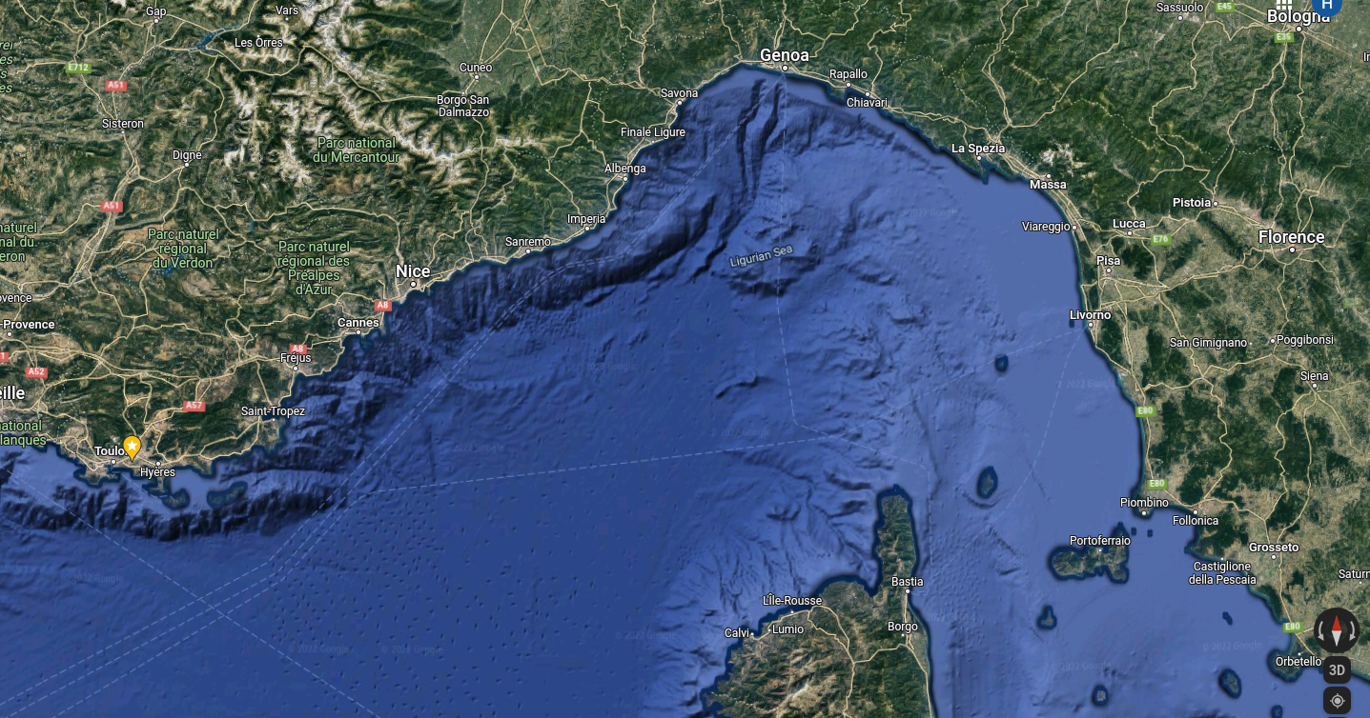
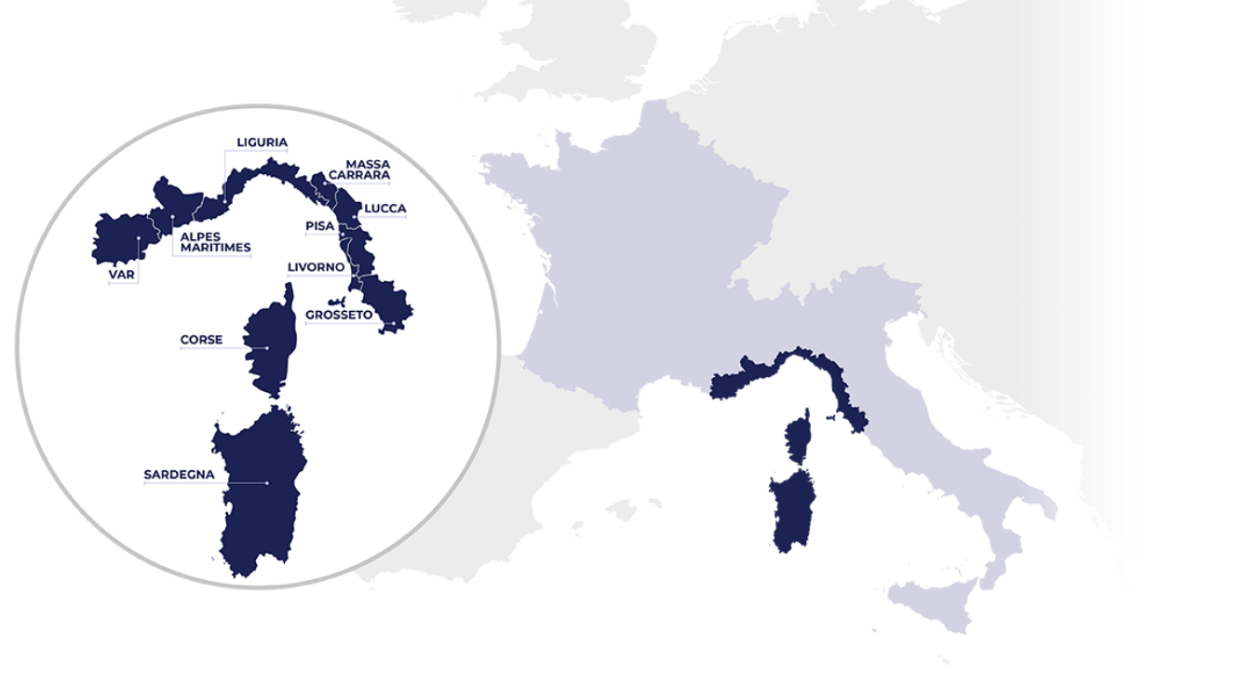
Optimisation of the placements
BX1
habitat of Cachalot
and rorqual &
high collision risk
BX2
military reason
habitat reason

Slide 4
Donner l’alerte sur les rapports des détections de BOMBYX
construction des densigrammes, exemples sur Bombyx1 (Toulon 2017)
density
of the probabilities
of detection of cachalot
Real data, one day
7 juillet 2015
with cachalot =
8 sept 2017
without cachalot =
smooth variations = true alert
no continuity = no alert

Slide 5
Usage of BOMBYX via REPCET :

Slide 6
Global system GIAS Bombyx DYNI
TOULON LIS LAB
density analysis
MIRACETI
Final decision & Alert SMS
to REPCET
GSM emission to UTLN of the
detection &
.wav samples
dive
azimuth,
distance, direction estimation
surface
Bombyx
sonobuoy
Decision to surface
feedback for next decision
Web map of historic
Alert to the
boats
Bombyx recording
Embedded
detections
AIS

